Slide 1


UNIT 1
Introduction to Software and Software Engineering

Slide 2



Content
The Evolution Role of Software
Software: A crises on the Horizon and Software Myths
Software Engineering: A Layered Methodology
Software Process Models
Component Based development, Process, Product & Process
Unit 1

Slide 3
IS SOFTWARE DEAD ?
If it was dead, you would not be reading Software Engineering
Unit 1
Unit 1

Slide 4
Defining Software
Software is
Instructions(Computer programs) that when execute provide desired features, functions and performance)
Data structures that enable the programs to adequately manipulate the information
Descriptive information in both hardcopy and virtual forms that describe the operation and use of the programs
Unit 1

Slide 5
Activity
Divide in a group of 4
Give team numbers
Make a group leader
All odd teams – topic is hardware
All even teams – topic is software
Hardware – design a chair (things required, design, implement, test)
Software – design any software (things required, design, implement, test)
Time = 15min
Unit 1

Slide 6
Characteristics of Software
Software is developed or engineered, it is not manufactured in the classical sense.
Software doesn't "wear out."
As the software is not susceptible to the environmental maladies that cause hardware to wear out
Software will undergo changes and as changes are made, errors will be introduced, causing failure rate curve to spike as shown in next slide
Although the industry is moving toward component-based construction, most software continues to be custom-built.
Unit 1

Slide 7
Wear vs Deterioration
Unit 1

Slide 8
Software Applications
System software
Application software
Engineering/scientific software
Embedded software
Product-line software
WebApps (Web applications)
AI software
Unit 1

Slide 9
New Categories
Open world computing—pervasive, distributed computing
Ubiquitous computing—wireless networks
Netsourcing—the Web as a computing engine
Open source—”free” source code open to the computing community (a blessing, but also a potential curse!)
Also …
Data mining
Grid computing
Cognitive machines
Software for nanotechnologies
Unit 1

Slide 10
Legacy Software
Most of the software's fall in the mentioned category but some programs are older, in some cases much older
These older programs are referred to as legacy software
Why must it change?
software must be adapted to meet the needs of new computing environments or technology.
software must be enhanced to implement new business requirements.
software must be extended to make it interoperable with other more modern systems or databases.
software must be re-architected to make it viable within a network environment.
Unit 1

Slide 11
WebApps
Network intensiveness. A WebApp resides on a network and must serve the needs of a diverse community of clients.
Concurrency. A large number of users may access the WebApp at one time.
Unpredictable load. The number of users of the WebApp may vary by orders of magnitude from day to day.
Performance. If a WebApp user must wait too long (for access, for server-side processing, for client-side formatting and display), he or she may decide to go elsewhere.
Availability. Although expectation of 100 percent availability is unreasonable, users of popular WebApps often demand access on a “24/7/365” basis.
Unit 1

Slide 12
Data driven. The primary function of many WebApps is to use hypermedia to present text, graphics, audio, and video content to the end-user.
Content sensitive. The quality and aesthetic nature of content remains an important determinant of the quality of a WebApp.
Continuous evolution. Unlike conventional application software that evolves over a series of planned, chronologically-spaced releases, Web applications evolve continuously.
Immediacy. Although immediacy—the compelling need to get software to market quickly—is a characteristic of many application domains, WebApps often exhibit a time to market that can be a matter of a few days or weeks.
Security. Because WebApps are available via network access, it is difficult, if not impossible, to limit the population of end-users who may access the application.
Aesthetics. An undeniable part of the appeal of a WebApp is its look and feel.
Unit 1

Slide 13
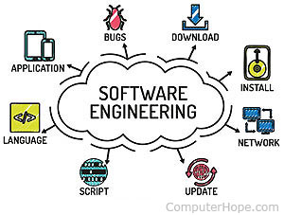
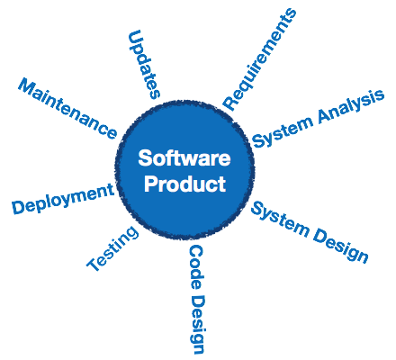
Software Engineering
Unit 1

Slide 14
Definition
The IEEE definition:
Software Engineering:
(1) The application of a systematic, disciplined, quantifiable approach to the development, operation, and maintenance of software; that is, the application of engineering to software.
(2) The study of approaches as in (1).
Unit 1

Slide 15

A Layered Technology
Unit 1

Slide 16
A Process Framework
Process framework
Framework activities
work tasks
work products
milestones & deliverables
QA checkpoints
Umbrella Activities
Unit 1

Slide 17
Framework Activities
Communication
Planning
Modeling
Analysis of requirements
Design
Construction
Code generation
Testing
Deployment
Unit 1

Slide 18
Umbrella Activities
Software project management
Formal technical reviews
Software quality assurance
Software configuration management
Work product preparation and production
Reusability management
Measurement
Unit 1

Slide 19
Adapting a process model
the overall flow of activities, actions, and tasks and the interdependencies among them
the degree to which actions and tasks are defined within each framework activity
the degree to which work products are identified and required
the manner which quality assurance activities are applied
the manner in which project tracking and control activities are applied
the overall degree of detail and rigor with which the process is described
the degree to which the customer and other stakeholders are involved with the project
the level of autonomy given to the software team
the degree to which team organization and roles are prescribed
Unit 1

Slide 20
Software Myths
Software Myths – wrong beliefs about software and the process that is used to build it – can be traced to the earliest days of computing.
Myths can be:
Management Myths
Customer Myths
Practitioner’s Myths
Unit 1

Slide 21
Management Myths:
Already there is a book that is full of standards and procedures for building software. Will not that provide the employees with everything they need to know.
In case management is behind schedule, can they add more programmers and catch-up?
If decided to outsource the software project to a third party, can management just relax and let that firm build.
Customer Myths:
A general statement of objectives is sufficient to begin writing programs – can the customer fill the details later.
Software requirements continuously change, but the change can be easily accommodated because software is flexible.
Unit 1

Slide 22
Contd..
Practitioner’s Myths:
Once the program is written and get it to work, the practitioner’s work is done.
Until the program is got for “running”, there is no way to assess the quality
The only deliverable work product for a successful project is the working project.
SE will make us create voluminous and unnecsary documentation and will invariable slow it down.
Unit 1

Slide 23
Contd…
Affect managers, customers (and other non-technical stakeholders) and practitioners
Are believable because they often have elements of truth,
but …
Invariably lead to bad decisions,
therefore …
Insist on reality as you navigate your way through software engineering
Unit 1

Slide 24
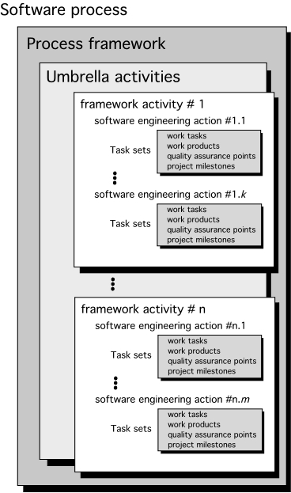
Process Models
Generic Process Model
Unit 1

Slide 25
Framework activities of process model
Mainly there are 5 framework activities:
Communication
Planning
Modeling
Construction
Deployment
Unit 1

Slide 26
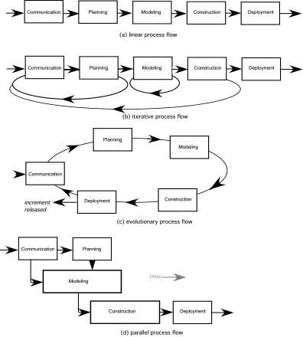
Process Flow
Unit 1

Slide 27
Question
How does a framework activity change as the nature of work changes?
(Hint) : Discuss with respect to a small project and a considerably more complex project with many stake-holders
Unit 1

Slide 28
Answer:
For small software project requested by 1 person with simple, straightforward requirements, the communication can be:
Make contact with stakeholder via telephone
Discuss requirements and take notes
Organize the notes into a brief written statement of requirements.
E-mail to stakeholder for review and approval.
Unit 1

Slide 29
Contd…
For considerably more complex project with multiple stakeholders:
Mindset of every stakeholder may be different.
Communication activity might have 6 distinct actions:
Inception
Elicitation
Elaboration
Negotiation
Specification
Validation
Unit 1

Slide 30
Prescriptive Models
Prescriptive process models advocate an orderly approach to software engineering
That leads to a few questions …
If prescriptive process models strive for structure and order, are they inappropriate for a software world that thrives on change?
Yet, if we reject traditional process models (and the order they imply) and replace them with something less structured, do we make it impossible to achieve coordination and coherence in software work?
Unit 1

Slide 31
The Waterfall Model
Unit 1

Slide 32
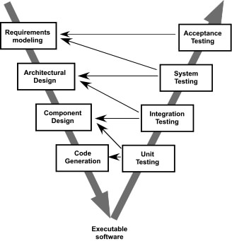
The V-Model
Unit 1

Slide 33
The Incremental Model
Unit 1

Slide 34
Evolutionary Models: Prototyping
Quick
plan
communication
Modeling
Quick design
Deployment
delivery &
feedback
Construction
of prototype
Construction
of prototype
Unit 1

Slide 35
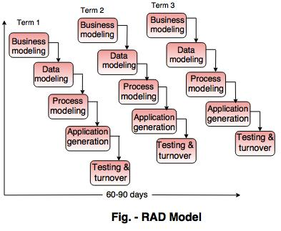
RAD Model [ Rapid Application Development Model ]
Unit 1

Slide 36
Evolutionary Models: The Spiral
Unit 1

Slide 37
Evolutionary Models: Concurrent
Unit 1

Slide 38
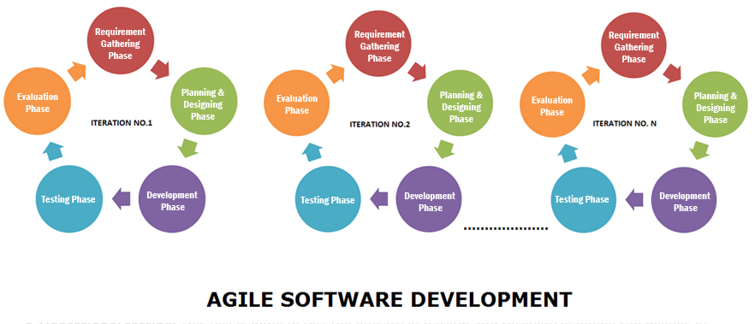
Agile Process Model

Slide 39
Still Other Process Models
Component based development—the process to apply when reuse is a development objective
Formal methods—emphasizes the mathematical specification of requirements
AOSD—provides a process and methodological approach for defining, specifying, designing, and constructing aspects
Unified Process—a “use-case driven, architecture-centric, iterative and incremental” software process closely aligned with the Unified Modeling Language (UML)
Unit 1

Slide 40
The Unified Process (UP)
elaboration
inception
Unit 1

Slide 41
UP Phases
Unit 1

Slide 42
UP Work Products
Unit 1

Slide 43
Personal Software Process (PSP)
Planning. This activity isolates requirements and develops both size and resource estimates. In addition, a defect estimate (the number of defects projected for the work) is made. All metrics are recorded on worksheets or templates. Finally, development tasks are identified and a project schedule is created.
High-level design. External specifications for each component to be constructed are developed and a component design is created. Prototypes are built when uncertainty exists. All issues are recorded and tracked.
High-level design review. Formal verification methods (Chapter 21) are applied to uncover errors in the design. Metrics are maintained for all important tasks and work results.
Development. The component level design is refined and reviewed. Code is generated, reviewed, compiled, and tested. Metrics are maintained for all important tasks and work results.
Postmortem. Using the measures and metrics collected (this is a substantial amount of data that should be analyzed statistically), the effectiveness of the process is determined. Measures and metrics should provide guidance for modifying the process to improve its effectiveness.
Unit 1

Slide 44
Team Software Process (TSP)
Build self-directed teams that plan and track their work, establish goals, and own their processes and plans. These can be pure software teams or integrated product teams (IPT) of three to about 20 engineers.
Show managers how to coach and motivate their teams and how to help them sustain peak performance.
Accelerate software process improvement by making CMM Level 5 behavior normal and expected.
The Capability Maturity Model (CMM), a measure of the effectiveness of a software process, is discussed in Chapter 30.
Provide improvement guidance to high-maturity organizations.
Facilitate university teaching of industrial-grade team skills.
Unit 1

Slide 45


